Slide 1

Identification & Optical character recognition (OCR) for Structured Documents
SBI - Hackathon

Slide 2
Problem Statement
01
In the contemporary world, there is a growing demand for the software systems to recognize characters in computer system when information is scanned through computer documents.
Comprehension of these document files is a challenge especially given the expected huge volumes of files that are expected to be generated on extending more use-cases to our client base of over 45 crore customers.

Slide 3
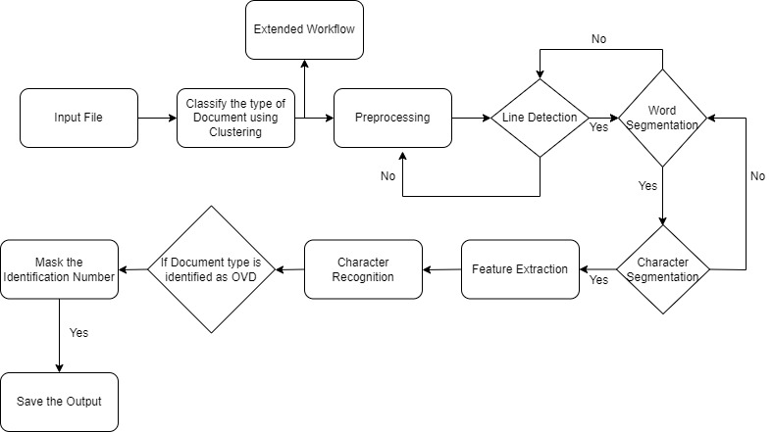
Proposed Solution
02
Details about Implementation of OCR

Slide 4
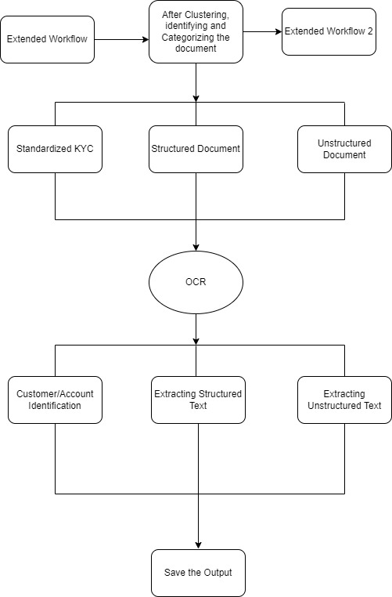
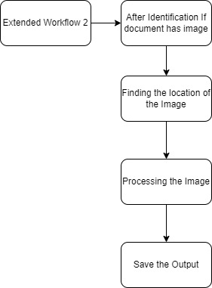
Proposed Solution
03
Images including Signatures, photographs and attestation

Slide 5
Benefits from the solution:
04
Capable of reading handwritten text.
The solution also classifies the type of document.
Capable in masking the private information.

Slide 6
Thank You

